Slide 1





The current scenario
Companies need to track learner data to measure learning effectiveness
This data is analyzed to make sense out of it and make business decisions
So far, majority of E-learning has used SCORM to do this
Businesses are looking to shift from SCORM to something that gives a more holistic view of the data

Slide 2



WHY xAPI ?
What’s missing ?
No offline learning support
Limited tracking metrics
LMS-only deployment

Slide 3
WHY xAPI ?
How does xAPI make this better ?
Measure the effectiveness of Learning
Get customized data through the LRS
Define personally curated metrics
Customized visual reports and dashboards
Record interactions as per our need
Get to know our learners better
Corelate metrics and performance
Make informed decisions with supporting data

Slide 4






Use Cases of xAPI
670,562
160,380
25%
1.17%
€2.5M
PRODUCTION HOURS
ENGAGEMENT
CUSTOMER CONVERSION RATE
RETURN ON INVESTMENT
EMPLOYEE COURSE HOURS
Some of the others :

Slide 5
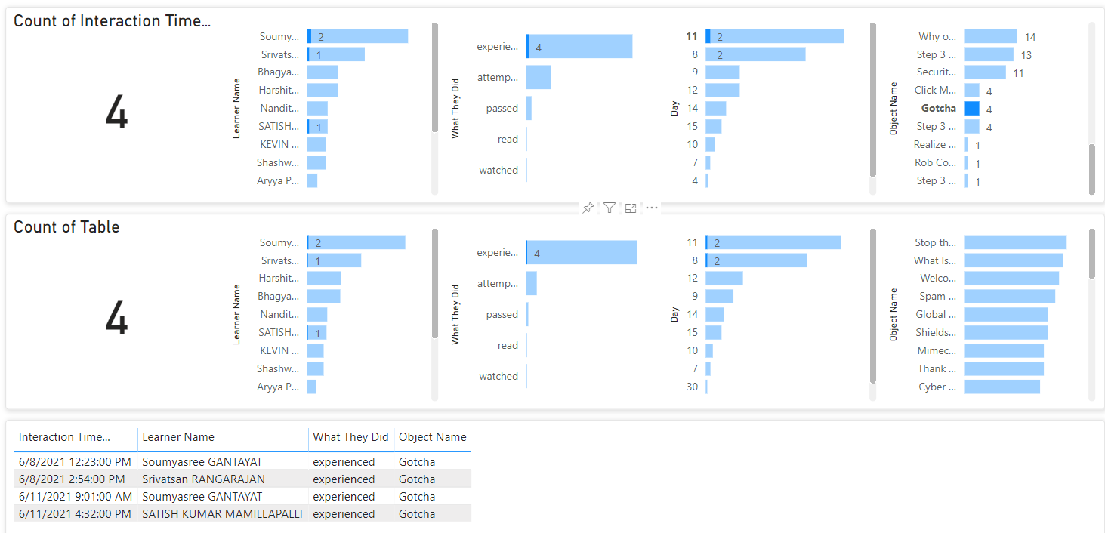
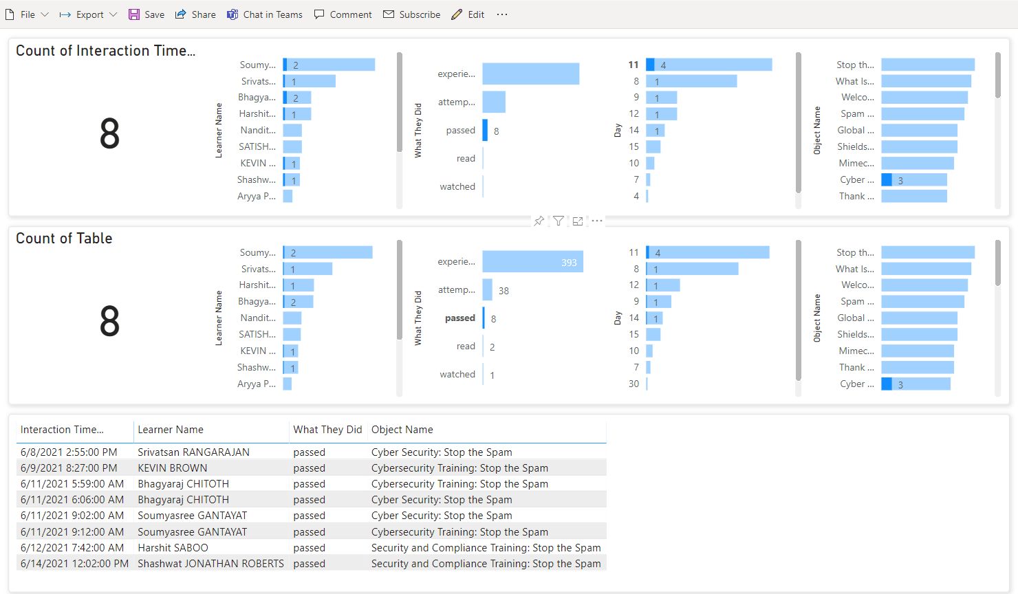
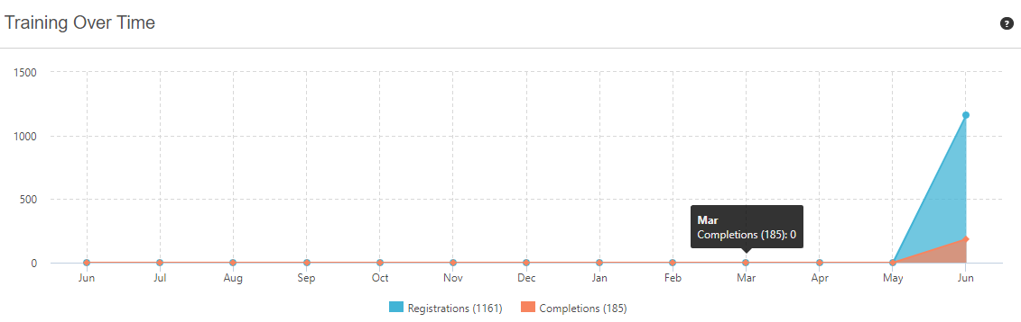
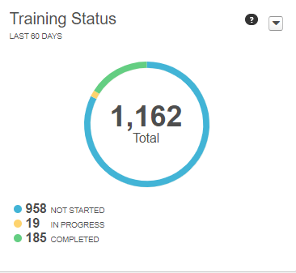
The POC (Visualised data for SPAM course)
DATA AVAILABLE THROUGH SCORM
DATA EXTRACTED THROUGH xAPI

Slide 6
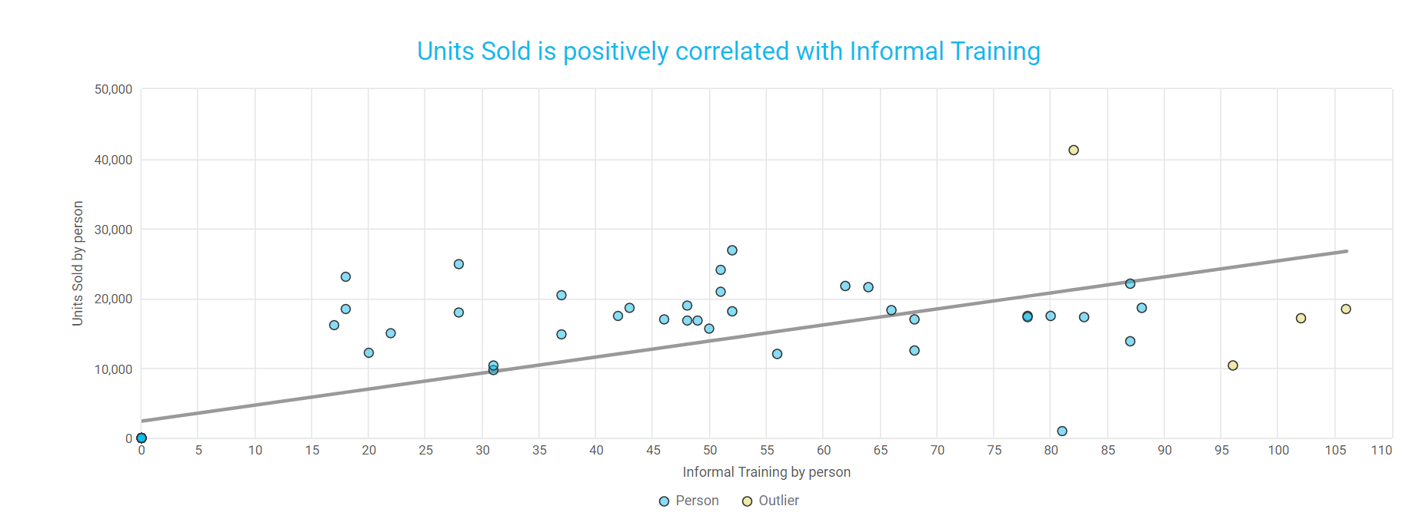
APPLICATIONS
Direct Correlation between business KPI and Learning

Slide 7
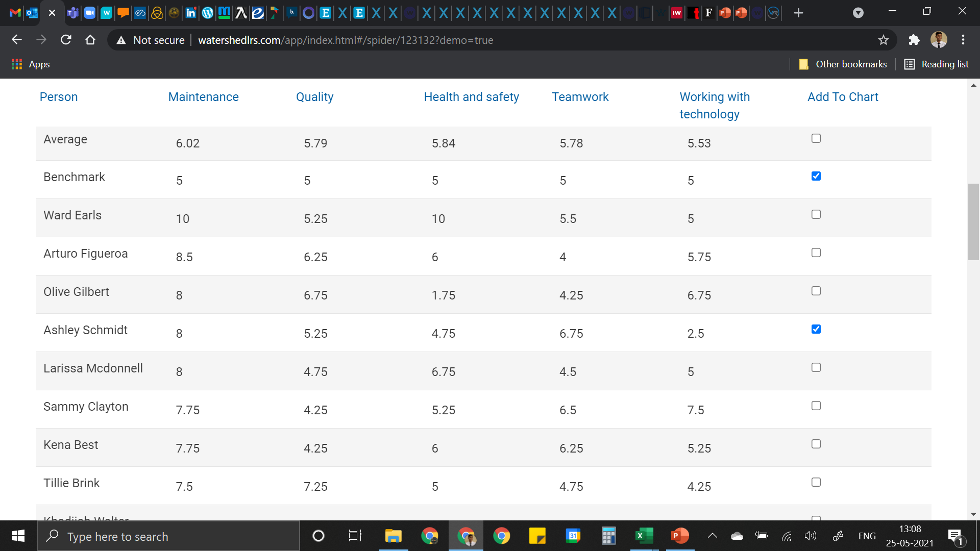
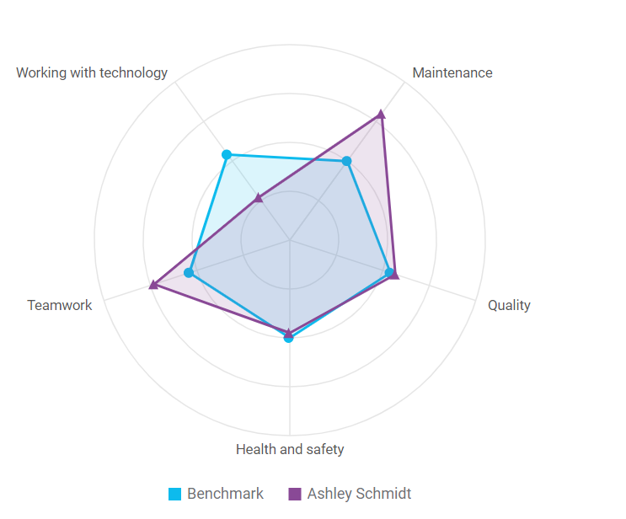
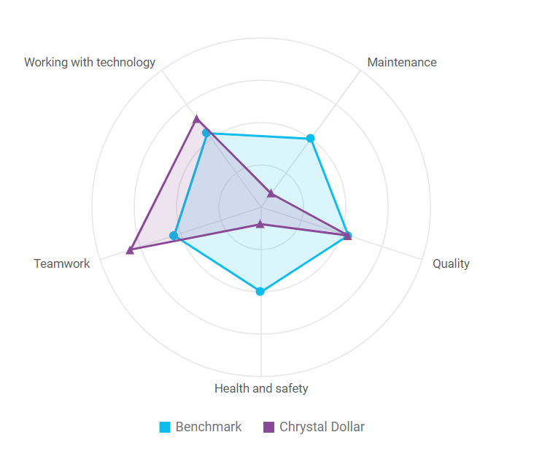
APPLICATIONS
Get to know learner strengths and weaknesses

Slide 8
THANK YOU !

